Slide 1
Agile and Scrum in Software Development
BY PRAJWAL RAJESH BHOSALE

Slide 2
AGILE SOFTWARE DEVELOPMENT
Agile Software Development is a flexible and iterative methodology focused on collaboration and customer satisfaction. It follows the Agile Manifesto, prioritizing individuals, working software, and adaptability. Agile emphasizes frequent deliveries and close customer involvement. This ensures continuous improvement and alignment with user needs.

Slide 3
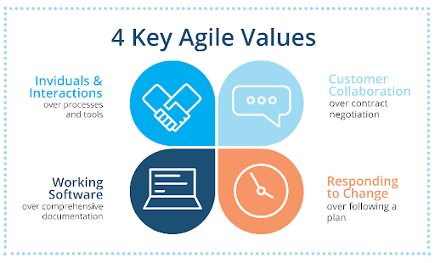
4 Core Values of Agile
Individuals and Interactions over Processes and Tools
Working Software over Comprehensive Documentation
Customer Collaboration over Contract Negotiation
Responding to Change over Following a Plan

Slide 4
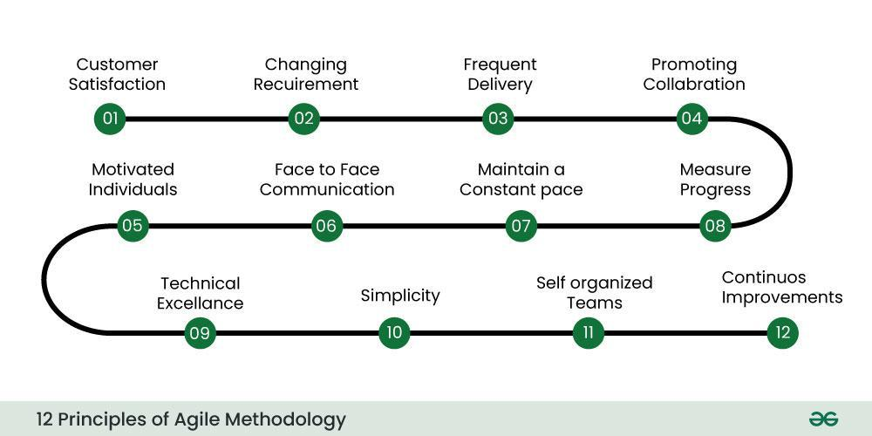
12 PRINCIPLES OF AGILE
Agile principles focus on early software delivery, adaptability to changes, and frequent releases. It emphasizes collaboration, individual empowerment, and face-to-face communication. Progress is measured by working software, with teams maintaining a sustainable pace. Excellence, simplicity, and self-organization drive productivity, while continuous reflection ensures ongoing improvements.

Slide 5
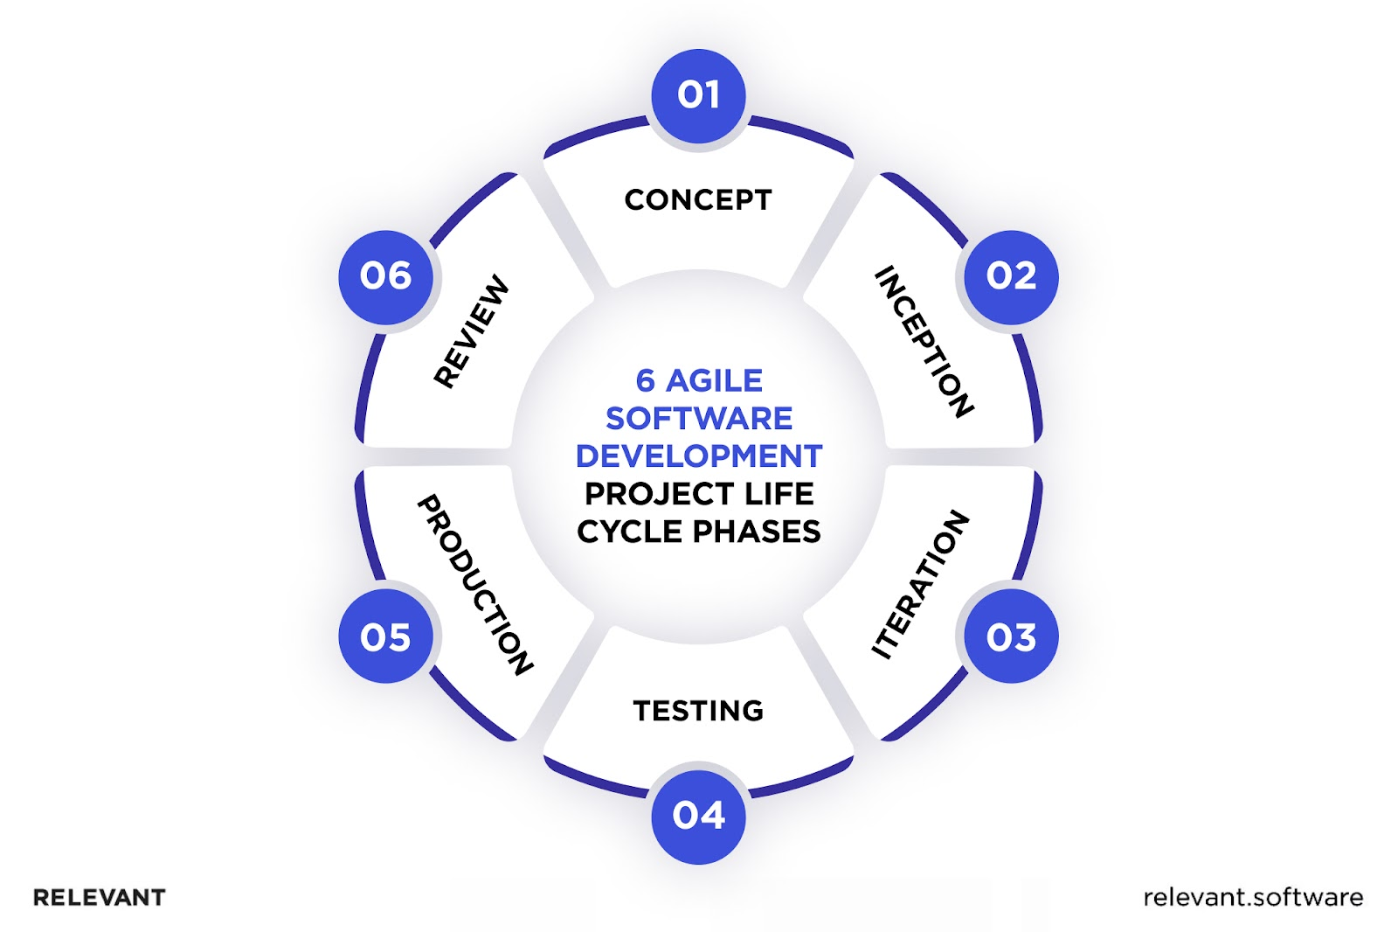
Agile Software Development Cycle
Concept – Identify project goals, feasibility, and high-level requirements.
Inception – Assemble the team, define the initial backlog, and plan development.
Iteration/Construction – Develop, test, and refine features in iterative sprints.
Release/Testing – Final testing, bug fixes, and deployment to users.
Production – Maintain, support, and improve the software based on feedback.
Review/Retirement – Phase out or replace the software when it's no longer needed.

Slide 6
AGLIE
Advantages
Disadvantages
Faster Deployment & Adaptability
Improved Collaboration & Quality
Higher Customer Satisfaction & Team Morale
Difficult Planning & Predictability
Heavy Dependency on Customer & Senior Developers
Risk of Burnout & Limited Documentation

Slide 7
SCRUM
Scrum is a management framework that helps teams self-organize and work towards a common goal. It enables high-value product development while maintaining creativity and productivity. The iterative and incremental approach allows teams to adapt to changing requirements. Scrum ensures efficiency in handling complex, adaptive problems.

Slide 8
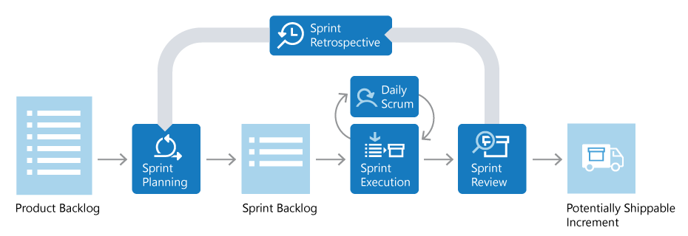
SCRUM LIFE CYCLE

Slide 9
WORKFLOW
Product Backlog – A prioritized list of features, enhancements, and fixes maintained by the Product Owner.
Sprint Planning – The Scrum Team selects tasks from the Product Backlog to include in the Sprint Backlog for the upcoming Sprint.
Sprint Backlog – A refined list of tasks selected for development in a sprint cycle (usually 2-4 weeks).
Sprint Execution – The development team works on implementing backlog items, refining, and testing them.
Daily Scrum – A short daily meeting where the team discusses progress, challenges, and plans for the day.
Sprint Review – A meeting at the end of the sprint where completed work is demonstrated to stakeholders for feedback.
Potentially Shippable Increment – A working product version that could be released if needed.
Sprint Retrospective – After the sprint, the team reflects on what went well, what didn’t, and how to improve the next sprint.

Slide 10
SCRUM
Advantages
Disadvantages
Increased transparency
Faster product delivery
Better risk management
Higher team efficiency
Requires experienced teams
Can be challenging to scale
Demands continuous collaboration

Slide 11
CONCLUSION
Agile and Scrum have transformed the software development process by improving flexibility, collaboration, and efficiency. They enable teams to deliver high-quality products that meet customer needs.

Slide 12
THANKS..!!

